Slide 1



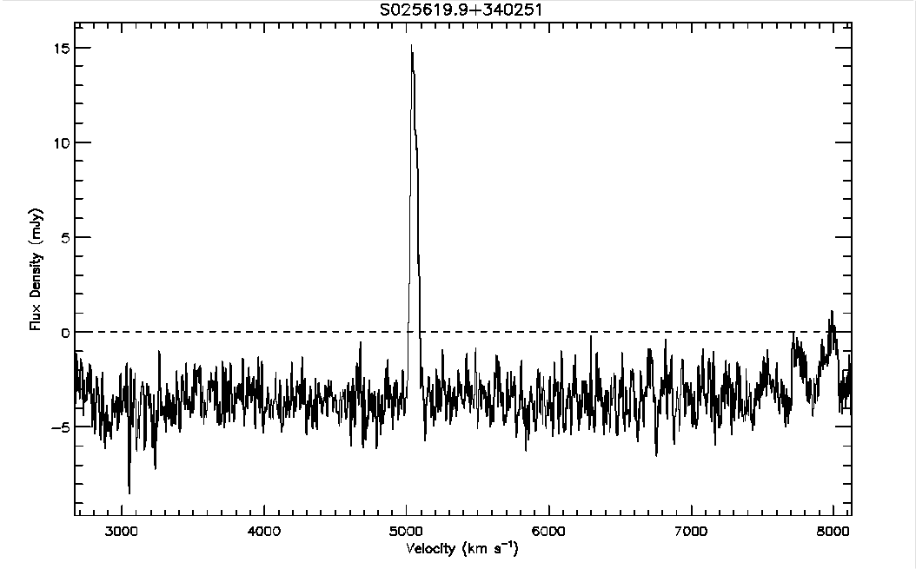
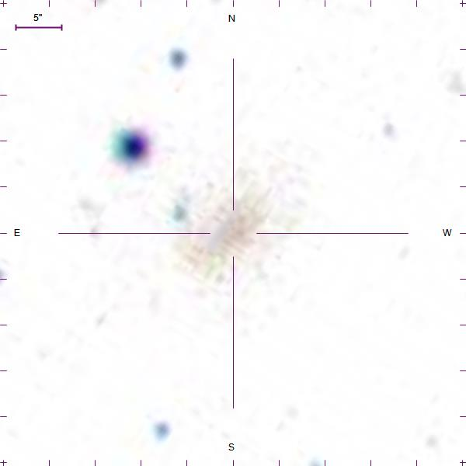
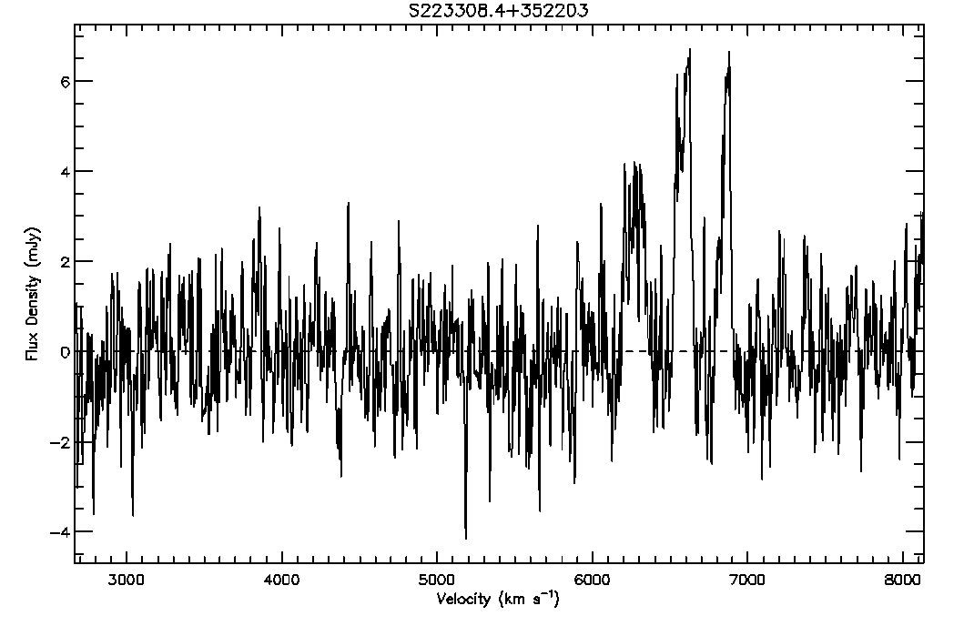
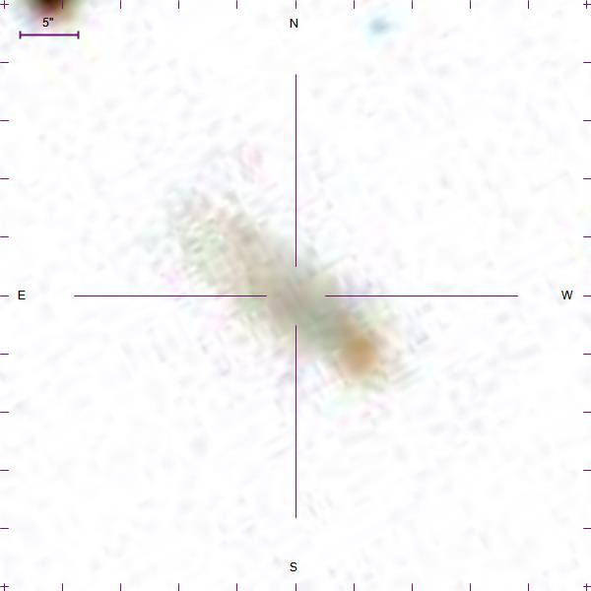
The Arecibo Pisces-Perseus Supercluster Survey: Declination Strip 35
Chelsey McMichael¹, J. Ribaudo¹, R. Koopmann², M. Haynes³, APPSS Team, Undergraduate ALFALFA Team
¹Utica College, ²Union College, ³Cornell University
The Arecibo Pisces-Perseus Supercluster Survey (APPSS) will provide strong observational constraints on the mass-infall rate onto the main filament of the Pisces-Perseus Supercluster. The survey data consist of HI emission-line spectra of cluster galaxy candidates, obtained primarily at the Arecibo Observatory (with ALFA as part of the ALFALFA Survey and with the L-Band Wide receiver as part of APPSS observations). Here we present the details of the data reduction process and spectral-analysis techniques used to determine if a galaxy candidate is at a velocity consistent with the Supercluster, as well as the detected HI-flux and rotational velocity of the galaxy, which will be used to estimate the corresponding HI-mass. We discuss the results of a preliminary analysis on a subset of the APPSS sample, corresponding to 98 galaxies located within ~1.5° of DEC = +35.0°, with 65 possible detections. We also highlight several interesting emission-line features and galaxies discovered during the reduction and analysis process and layout the future of the APPSS project.
This work has been supported by NSF grants AST-1211005 and AST-1637339.
ABSTRACT

